Slide 1
Session 10
Probability
Independence
Pairwise independence
Mutual independence

Slide 2
Probability Theory
Probability theory deals with the study of random phenomena, which under repeated experiments yield different outcomes that have certain underlying patterns about them.
The notion of an experiment assumes a set of repeatable conditions that allow any number of identical repetitions.

Slide 3
Probability
The Probability of an event A is defined a-priori without actual experimentation as
provided all these outcomes are equally likely.

Slide 4
Example of Probability
Consider a box with n white and m red balls. In this case, there are two elementary outcomes: white ball or red ball. Probability of “selecting a white ball”
We can use above classical definition to determine the
probability that a given number is divisible by a prime p.

Slide 5
Why do we need probability?
In an uncertain world, it can be of immense help to know and understand chances of various events.
Example:
If it’s likely to rain, I would carry my umbrella.
If I am likely to have diabetes on the basis of my food habits, I would get myself tested.
If my customer is unlikely to pay me a renewal premium without a reminder, I would remind him about it. So knowing the likelihood might be very beneficial.

Slide 6
Importance of Probability
Data science work is experienced as programming, almost everything that data scientists do involves working with statistics.
Data scientists make predictions, they’re dealing with probabilities.
The concept of probability might seem basic, but it’s the foundation for even the most advanced predictive models.

Slide 7
Importance of Probability
And while the actual mathematical operations are often baked into popular data science libraries for quick application
This convenience can be a double-edged sword.
A technique is easy to apply, after all, doesn’t mean that it’s correct to apply in every circumstance.

Slide 8
Why probability needed for Data Science
In the context of data science, statistical inferences are often used to analyze or predict trends from data.
These inferences use probability distributions of data.
Efficacy of working on data science problems depends on probability and its applications to a good extent.

Slide 9
Why probability needed for Data Science
Learning probability and statistics concepts, important for data scientists.
When we understand the why, it becomes much easier for you to identify the correct statistical technique or calculation for the problem you’re trying to solve.
It also becomes easier to explain our analysis to others when we have a firm grasp of why we used the technique you chose.

Slide 10
Statistical Analysis for Data
Statistical Analysis is the science of the exploration of the collection of large datasets to find different hidden patterns and trends.
These types of analyses are used in every sort of data for example in research and multiple industries, etc. so as to
Come to decisions that are to be modeled.

Slide 11
Types of Statistical Analysis
Quantitative Analysis: The type of analysis is defined as the science of fetching and interpreting the data with graphs and numbers to search for underlying hidden trends.
Qualitative Analysis: The type of Statistical analysis that gives the common information by making use of text and other forms of media.

Slide 12
Population or Sample Data
Before performing any analysis of data, we should determine if the data we’re dealing with is population or sample.
Population: Collection of all items (N) and it includes each and every unit of our study. It is hard to define and the measure of characteristic such as mean, mode is called parameter.
Sample: Subset of the population (n) and it includes only a handful units of the population. It is selected at random and the measure of the characteristic is called as statistics.

Slide 13
Probability (review)Some Properties
If B⊆A then P(A) ≥ P(B)
P(A⋃B) ≤ P(A) + P(B)
P(A⋂B) ≤ min(P(A), P(B))
P(¬A) = P(Ω / A) = 1 - P(A)
/ is set difference
P(A⋂B) will be notated as P(A, B)

Slide 14
Example of Python code
Determine the probability of drawing an Ace with the help of Python:
cards = 52
# Outcomes
aces = 4
# Divide possible outcomes by the sample set ace_probability = aces / cards
# Print probability rounded to two decimal places print(round(ace_probability, 2))
# Ace Probability Percent Code
ace_probability_percent = ace_probability * 100
# Print probability percent rounded to one decimal place print(str(round(ace_probability_percent, 0)) + '%')

Slide 15
Conditional Probability
Example:
100 college students were surveyed and asked how many hours a week they spent studying. The results are in the table below. Find the probability that a student spends more than 10 hours studying given that the student is a male.
 | Less then 5 | 5 to 10 | More than 10 | Total
Male | 11 | 22 | 16 | 49
Female | 13 | 24 | 14 | 51
Total | 24 | 46 | 30 | 100
The sample space consists of the 49 male students. Of these 49, 16 spend more than 10 hours a week studying.
P (more than 10 hours|male)

Slide 16
Conditional Probability
A conditional probability is the probability of an event occurring, given that another event has already occurred.
P (B |A)
“Probability of B, given A”

Slide 17
Independence of events
Two events E and F are said to be independent if and only if P(E ∩ F)=P(E)P(F).
If the above condition is not satisfied, then we say the two events E and F are dependent.
When we say two events are independent, we are saying that if event E has occurred, this will not effect the probability of event F.
INDEPENDENT EVENTS: The occurrence of one event has no effect on the probability of the other.

Slide 18
Mutually Independent
A set of events is said to be mutually independent if the probability of each event in the set is the same no matter which of the other events has occurred.
This is equivalent to saying that for any selection of two or more of the events, the probability that all the selected events occur equals the product of the probabilities of the selected events.

Slide 19
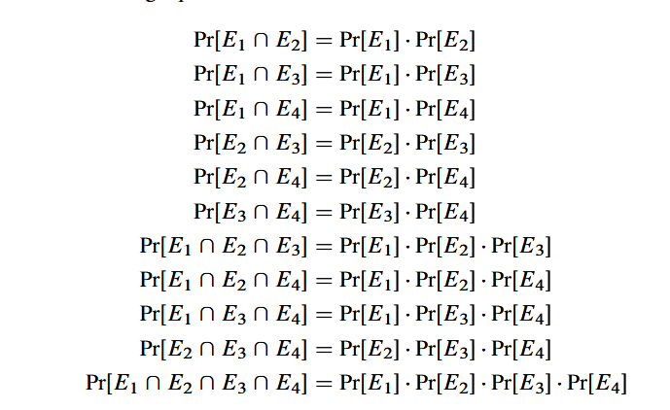
Example
For example, four eventsE1;E2;E3;E4 are mutually independent if and only if all of the following equations hold:

Slide 20
Pairwise Independence
A setA1,A2, . . . , of events is k-way independent iff every set of k of these events is mutually independent. The set is pairwise independent iff it is 2-way independent.
So the eventsA1,A2,A3 above are pairwise independent, but not mutually independent.
Pairwise independence is a much weaker property than mutual independence.

Slide 21
Example
We throw two dice. Let A be the event “the sum of the points is 7”,B the event “die # 1 came up 3”, and C the event “die #2 came up 4”.
Now,
P[A] =P[B] =P[C] =1/6.
Also, P[A∩B] =P[A∩C] =P[B∩C] =1/36
so that all events are pairwise independent. However, P[A∩B∩C] =P[B∩C]=1/36
While P[A]P[B]P[C] =1/216
so they are not independent as a triplet.

Slide 22
Example(cont.)
First, note that,
indeed, P[A∩B] =P[B∩C] =1/36,
since the fact that A and B occurred is the same as the fact that B and C occurred

Slide 23
Example of Python code for Probability problem
Determine the probability of the following mutually exclusive events;
Drawing a heart or drawing a club;
Drawing an ace, a king or a queen.
# Sample Space
cards = 52
# Calculate the probability of drawing a heart or a club
hearts = 13
clubs = 13
heart_or_club = event_probability(hearts, cards) + event_probability(clubs, cards)
# Calculate the probability of drawing an ace, king, or a queen
aces = 4
kings = 4
queens = 4
ace_king_or_queen = event_probability(aces, cards) + event_probability(kings, cards)
+ event_probability(queens, cards)
print(heart_or_club)
print(ace_king_or_queen)

Slide 24
Data Science techniques based on Probability
A number of data science techniques depend on Bayes theorem.
It’s a formula that demonstrates the probability of an event depending on the prior knowledge about the conditions that might be associated with the event.
Reverse probabilities can be found out using the Bayes theorem if the conditional probability is known to us.

Slide 25
Data Science techniques based on Probability
With the help of this theorem, it’s possible to develop a learner that is capable of predicting the probability of the response variable of some class, given a fresh set of attributes.
Implementing of code interconnect the knowing possibilities.

